Slide 1
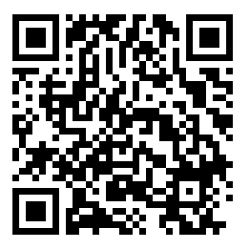
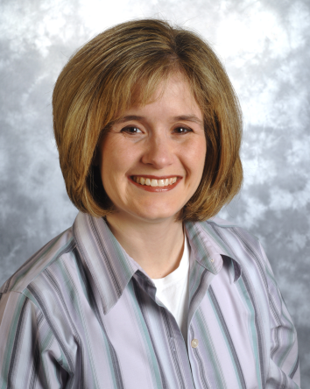
2023 Managing Pediatric Prehospital Care Webinar Series, Part 2
“Out of Hospital Management of the Newborn”
Wednesday, May 3rd at 11:00am
Registration Link (or above QR code)
Dr. Jennifer Grow, MD
Interim Director, Division of Neonatology; Medical Director, Akron NICUs; Clinical Professor of Pediatrics – Northeastern Ohio Medical University
Board Certified in Neonatal-Perinatal Medicine
CE available through NCH Cloud CME
For more information, please visit our website
Ohio PECC Member's Page

